Slide 1



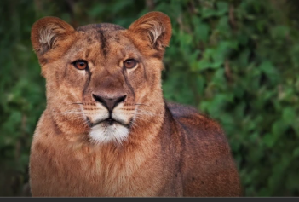
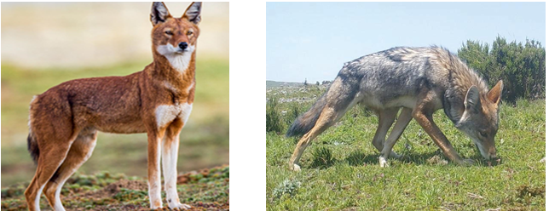

Enhancing Human-Wildlife Coexistence in Ethiopia: Challenges and Opportunities
By Tariku Mekonnen Gutema
(PhD in Wildlife Ecology and Management), March 3/2025

Slide 2
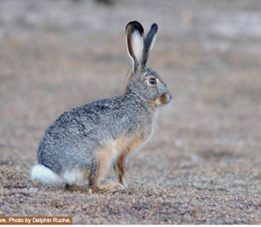
Contents
Introduction
  Wildlife resources
  Why Do We Conserve Wildlife?
Challenges and Causes of conflict
Mitigation measures (Opportunities)
Summary

Slide 3
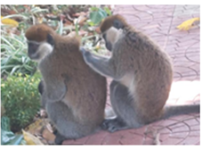
Question: For human-wildlife conflict management, which approach do you believe is most effective?
a) eradicating wildlife,
b) carefully developing coexistence measures,
c) selectively eliminating specific problematic wildlife
d) not sure.

Slide 4

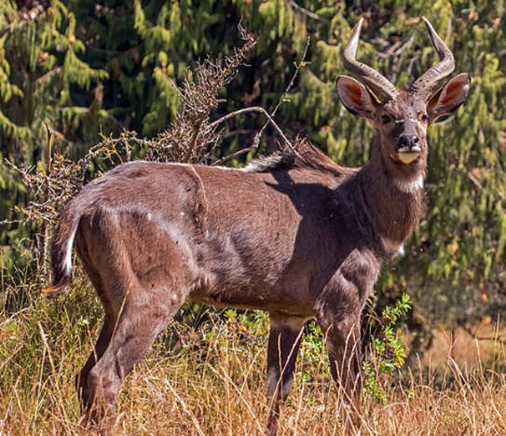
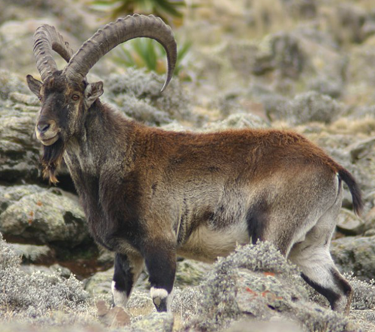
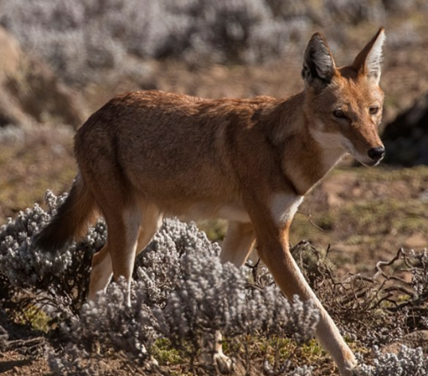
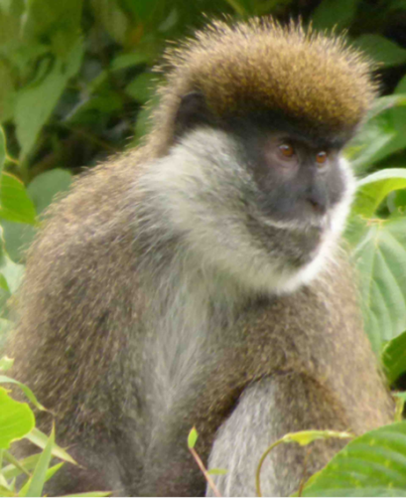
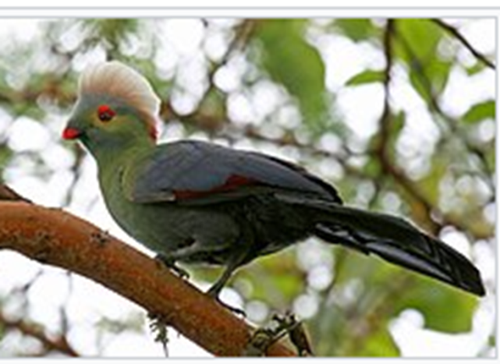
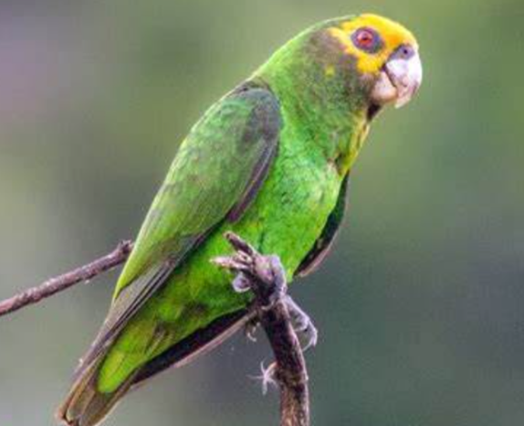
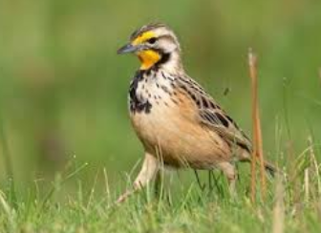
Ethiopia: major biodiversity hotspot globally
is among the top three countries in Africa with highest Endemic species
Madagascar and South Africa

Slide 5
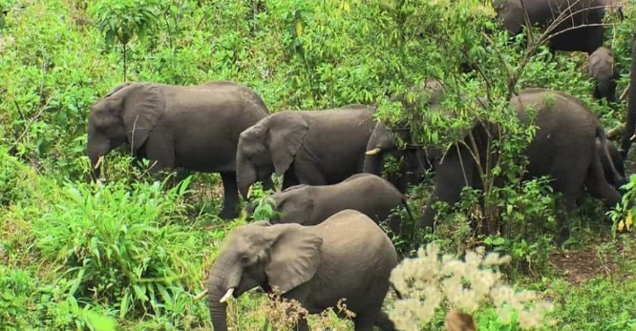
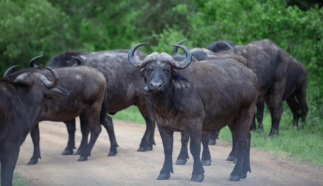
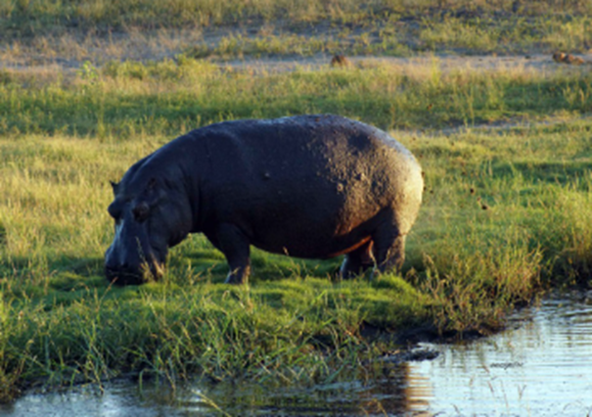
Wildlife resources South western Ethiopia
Big mammals (Elephant, buffalo, hippo)

Slide 6
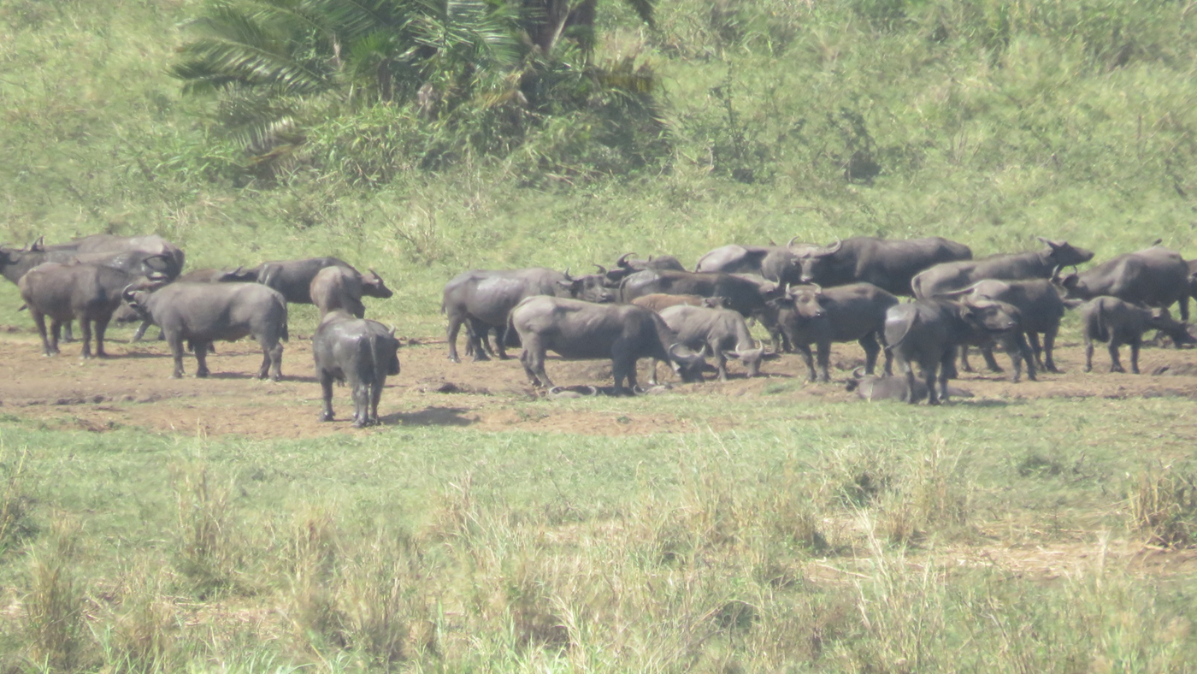
Buffalo

Slide 7
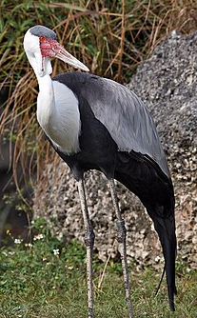
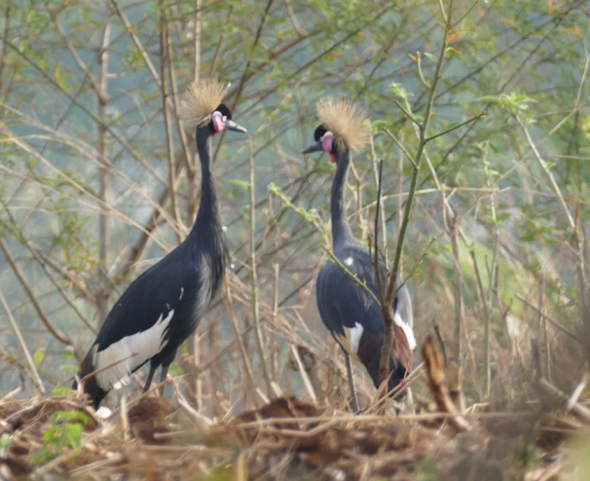
Wattled and Black crowned cranes

Slide 8
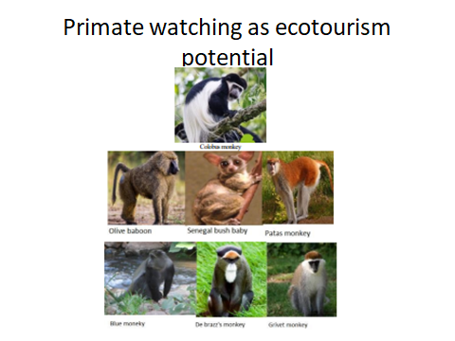

Slide 9
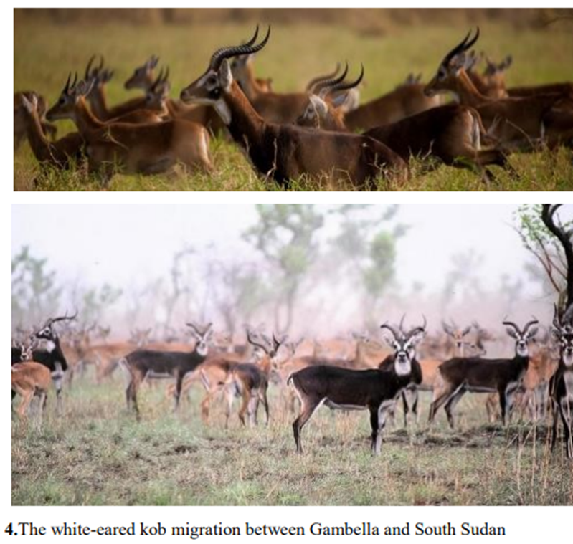
The largest migration between Gambella and South Sudan (Boma)

Slide 10
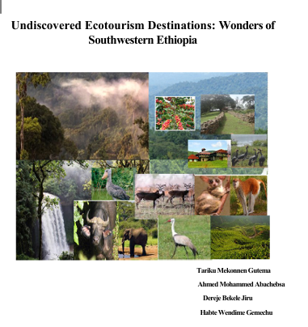

Slide 11
Why do we conserve wildlife?

Slide 12
Ecological value of wildlife

Slide 13
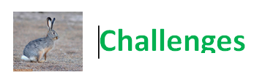
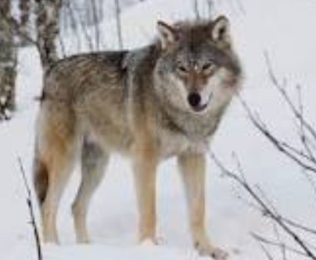
Human-wildlife conflict (HWC) is increasing globally

Slide 14
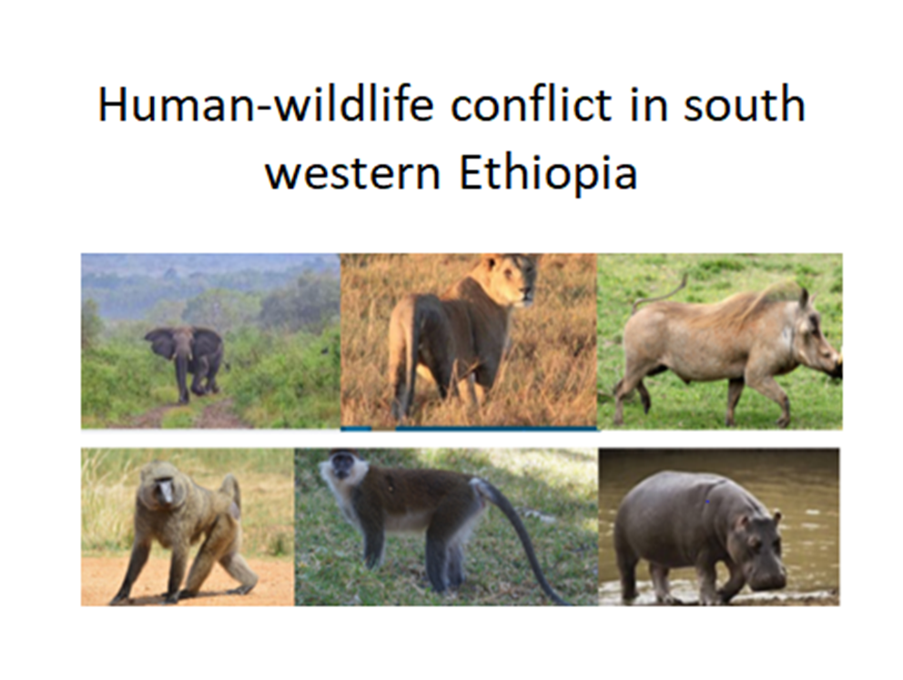
HWC in SWE
Crop damage,
livestock depredation,
human attacks

Slide 15
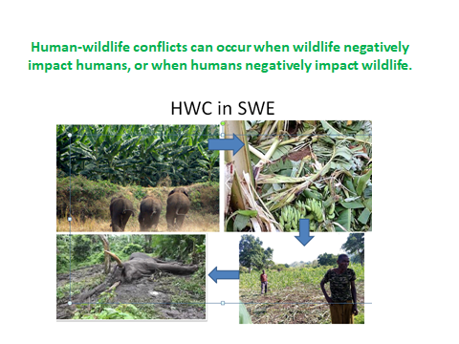

Slide 16
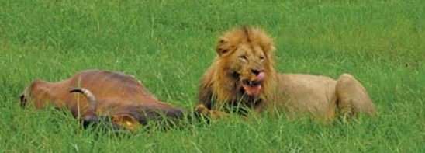
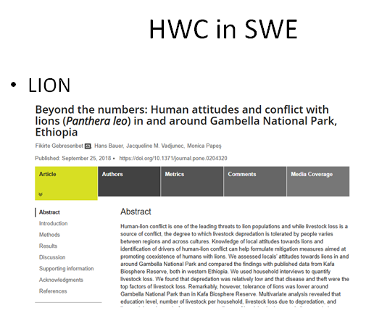
Lion kills livestock

Slide 17
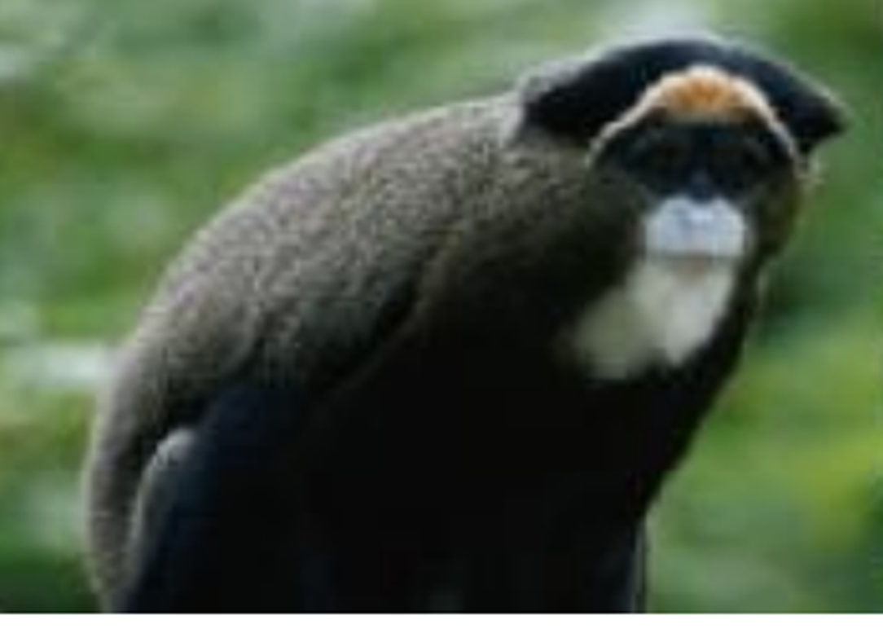
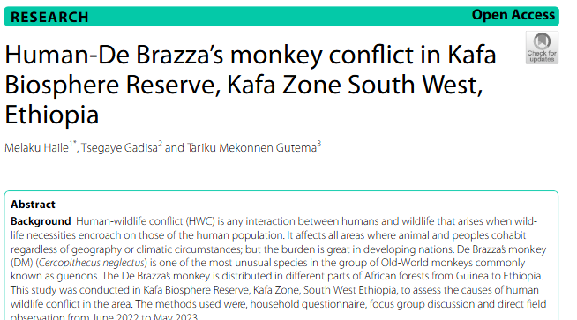
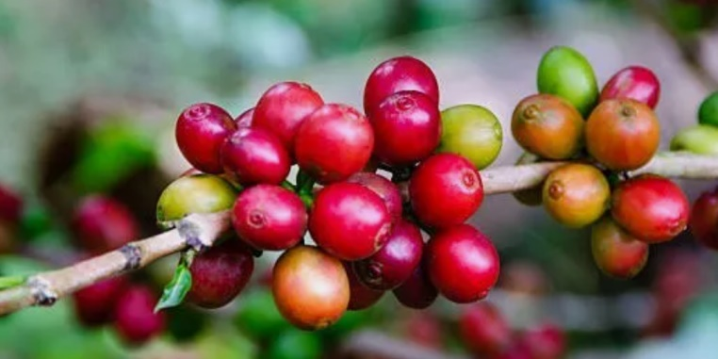
De Berazza’s monkey

Slide 18
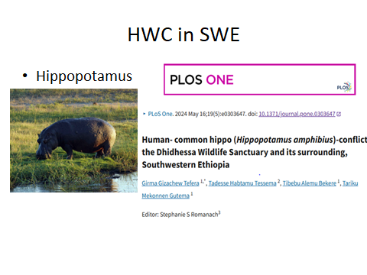
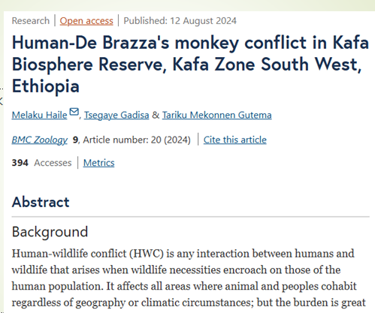

Slide 19
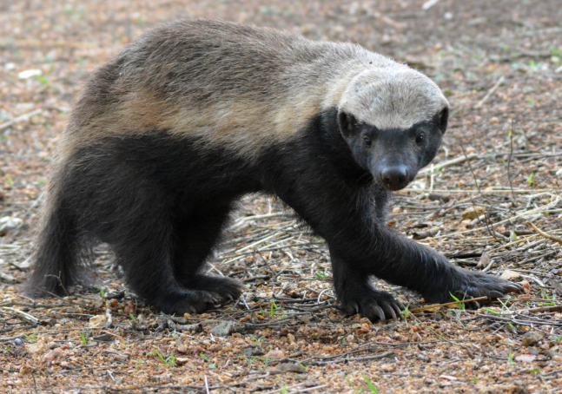
Honey Badger: Significant challenge for Beekeeping
consume both honey and bee larvae

Slide 20
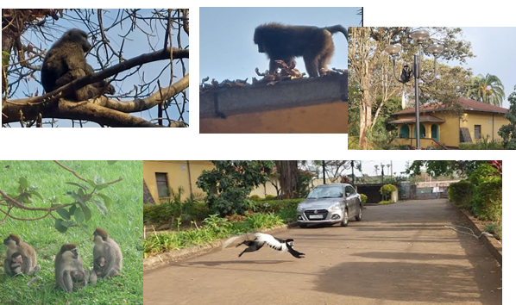
Wildlife migration toward cities are increasing?

Slide 21
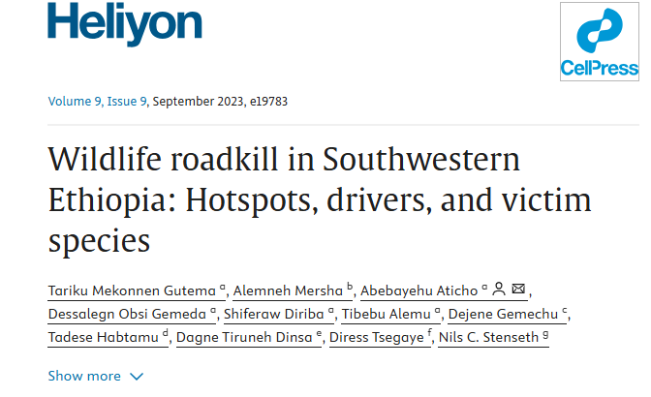
Road kill (study from Jimma)

Slide 22

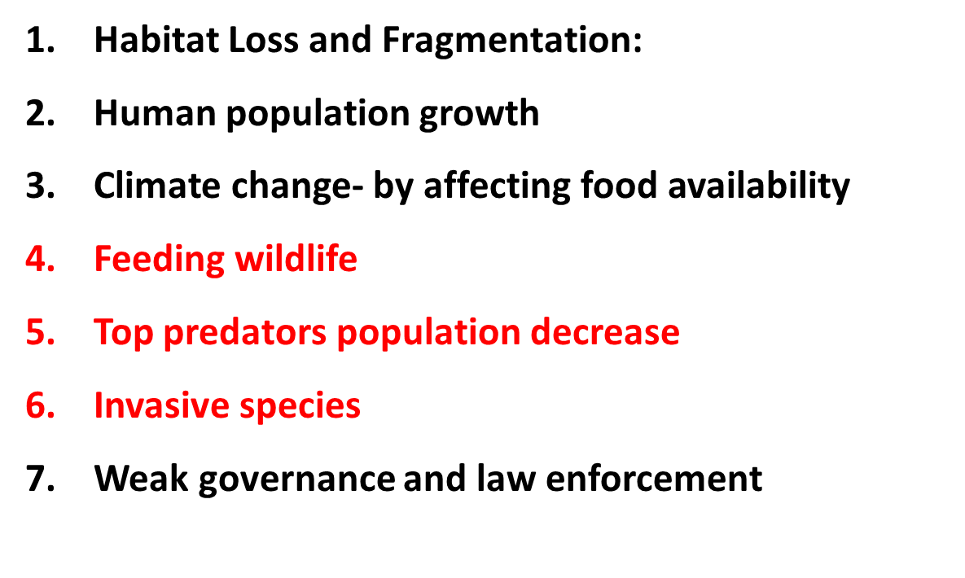
Causes

Slide 23
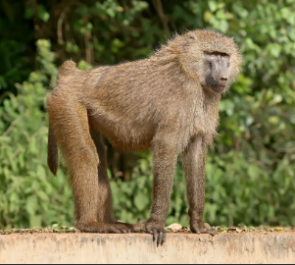
Feeding wildlife

Slide 24


Top predators population decrease

Slide 25

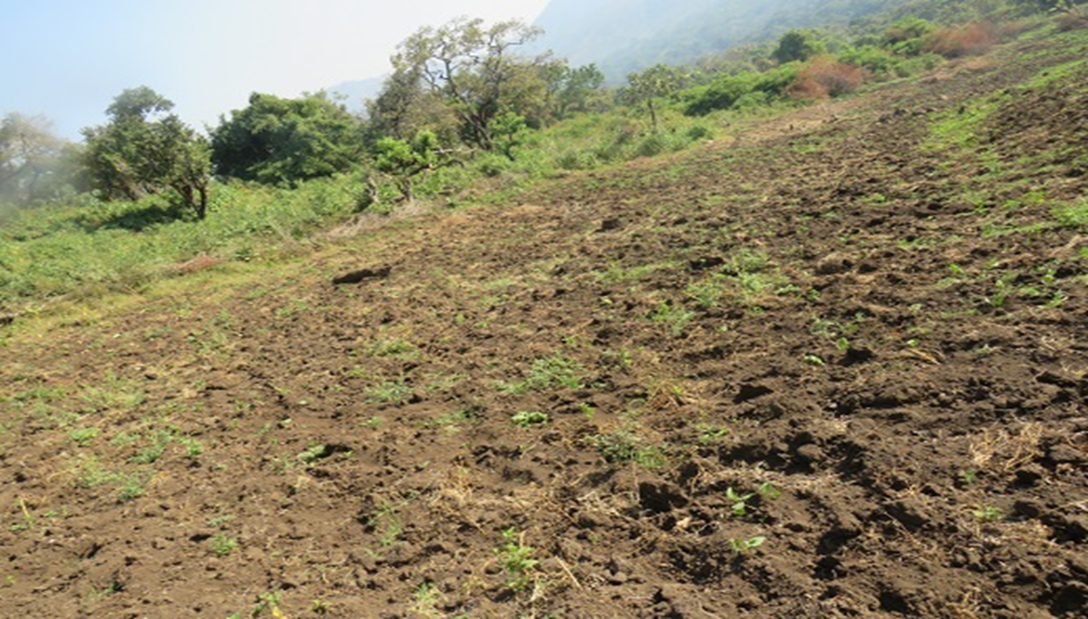
Opportunities (Mitigation measures)
1. Sustainable Land Use Planning
wildlife corridors, develop buffer zones around protected areas
2.

Slide 26
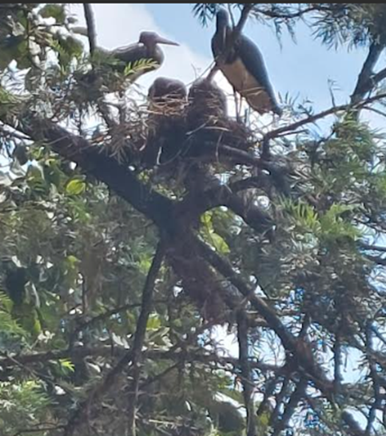
2. Encourage land-sharing approaches

Slide 27

3. Community Engagement & Livelihood Diversification, agroforestry
Strengthening Policy and Governance:
5. Habitat restoration
6. Wildlife population management

Slide 28
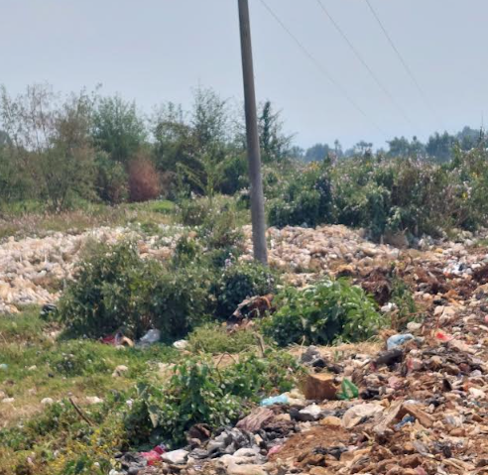
7. Remove things that attract wildlife to human settlement
8. Education & Awareness
9. Integrating Traditional Knowledge

Slide 29
Summary
Enhancing human-wildlife coexistence does not mean tolerance
It is minimizing negative interactions and boosting beneficial relations for mutual benefit,
That we can construct a future in which both human and wildlife coexist

Slide 30
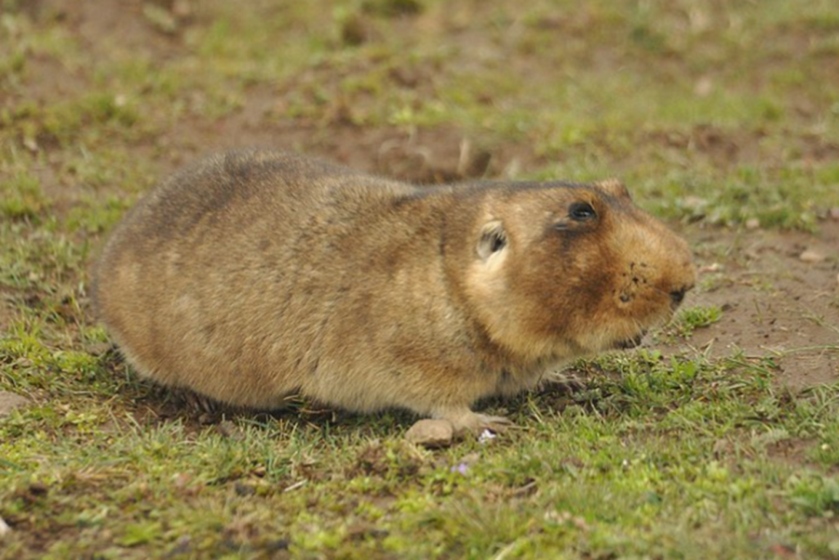
Do you want to revise your earlier answer to the question provided in the beginning?

Slide 31


