Slide 1





Ecology of African and Ethiopian wolves presentation on world Jackal day
https://www.goldschakal.at/world-jackal-day/

Slide 2

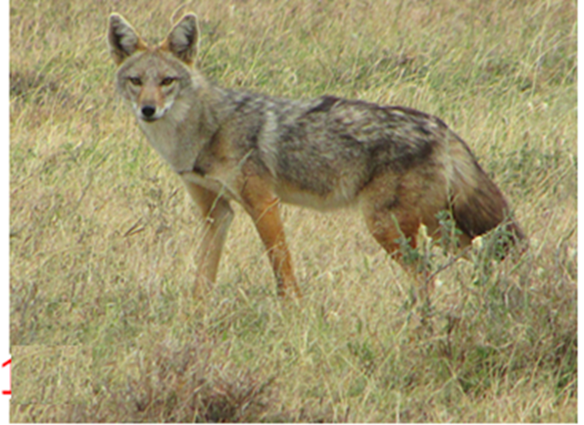
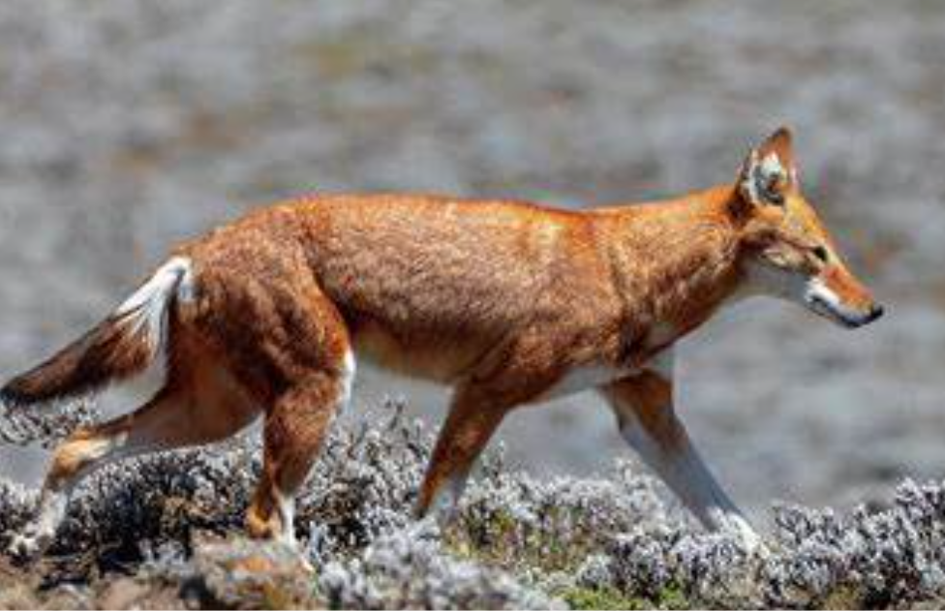


Ecology of African wolf (Canis lupaster) and Ethiopian wolf (Canis simensis)
Tariku Mekonnen Gutema
¨PhD in wildlife Ecology and Management
Jimma University, Ethiopia

Slide 3
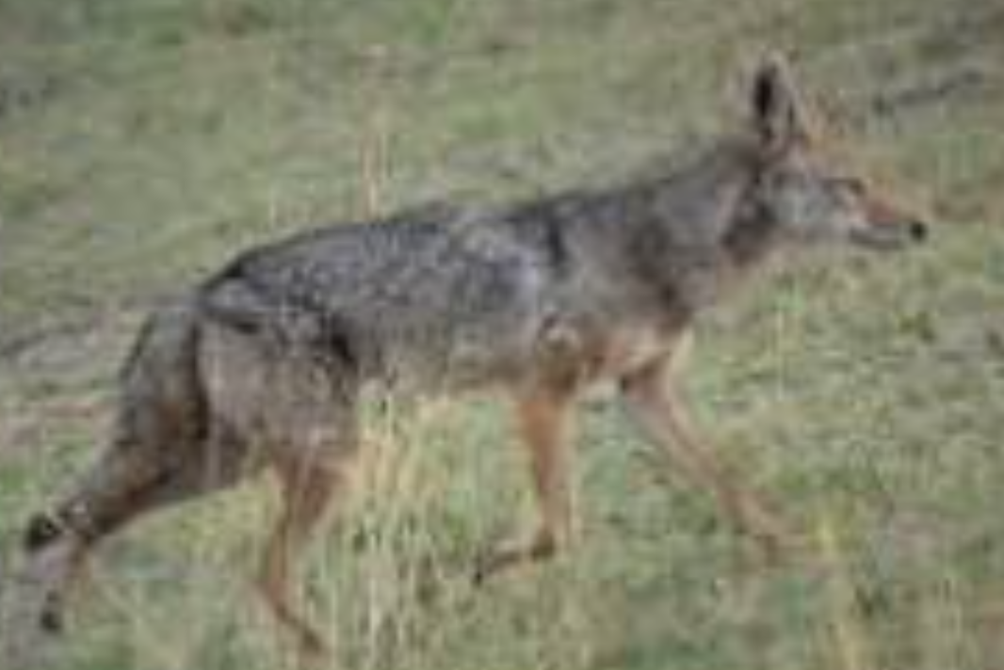

Newly discovered African wolf Study

Slide 4
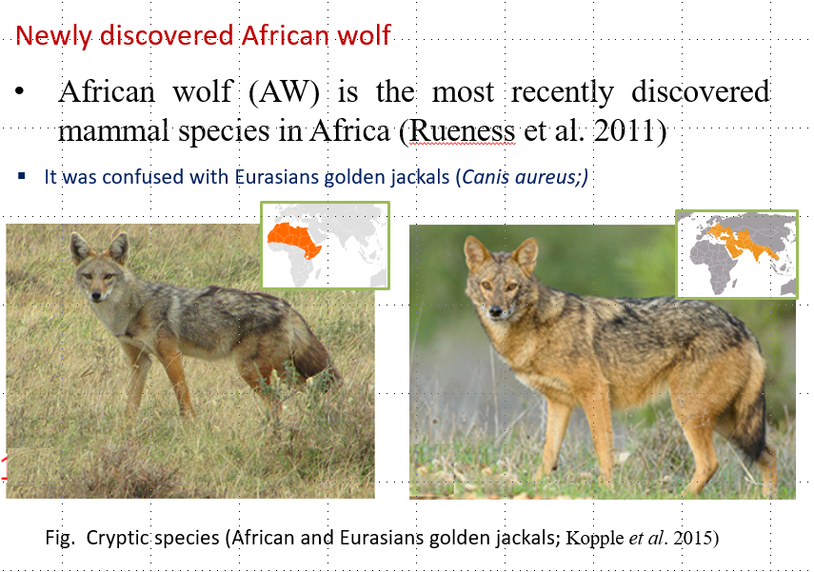


Slide 5
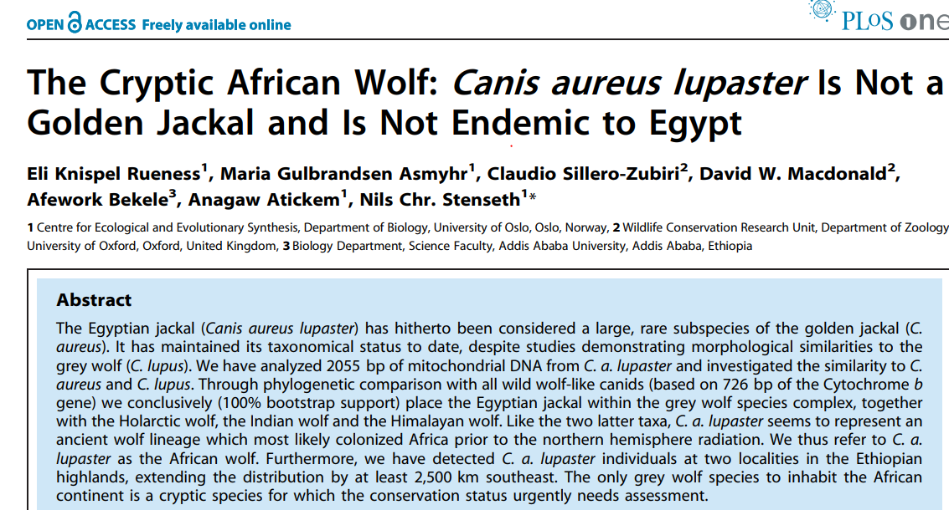
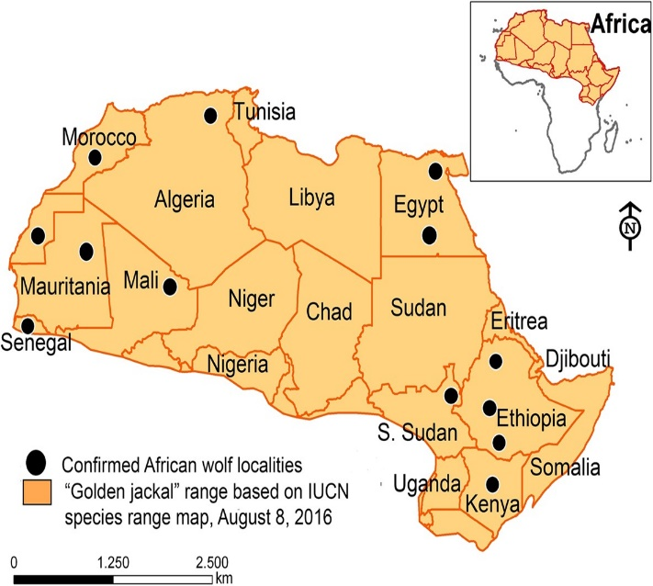
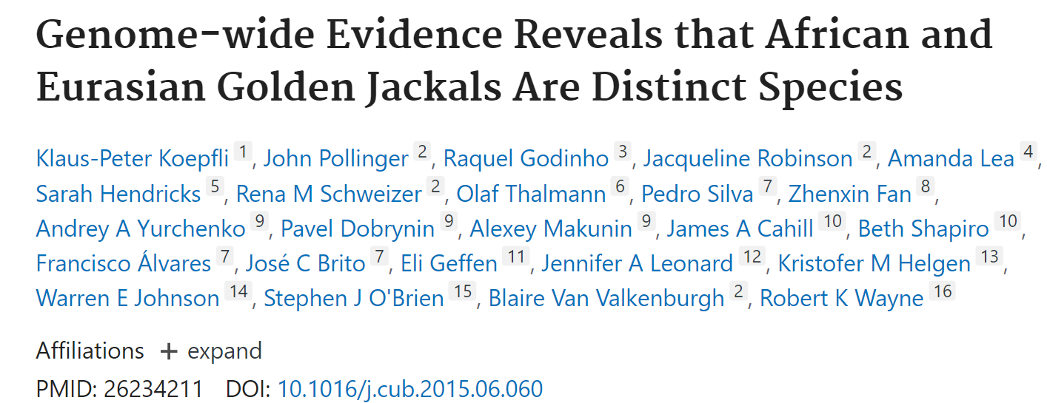
African wolf Distribution
Recent studies confirmed that the African golden jackals are wolves
Rueness et al. 2011
Gaubert et al. 2012
Kopple et al. 2015
Viranta et al. 2017
Fig. Confirmed African wolf localities (Viranta etal. 2017)

Slide 6
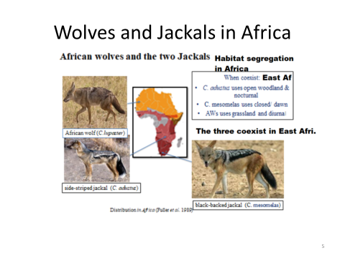

Slide 7
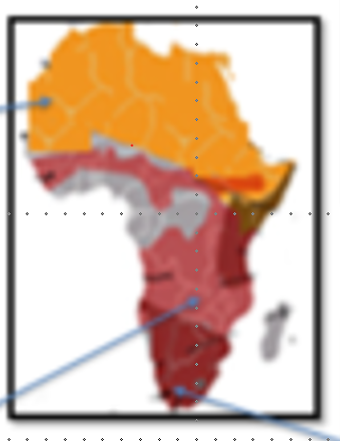
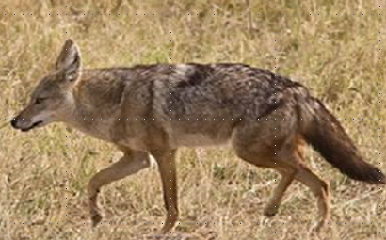
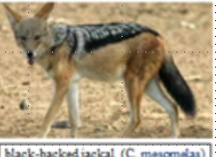
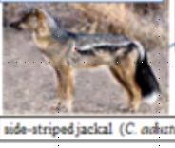
African wolf and Jackals distribtuion in Africa
African wolf

Slide 8
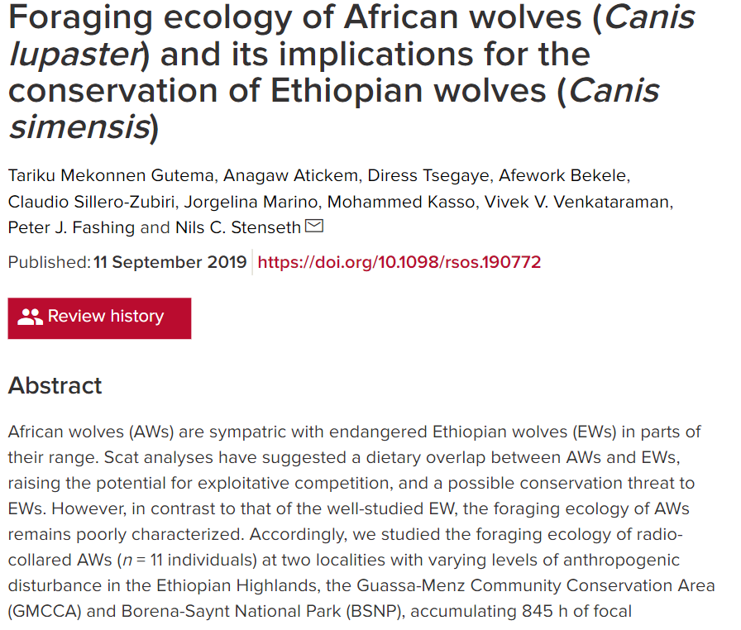
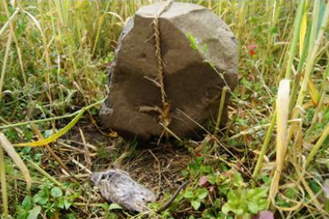
Feeding ecology of African wolves
Rodents killed by local community using indegenous methods

Slide 9

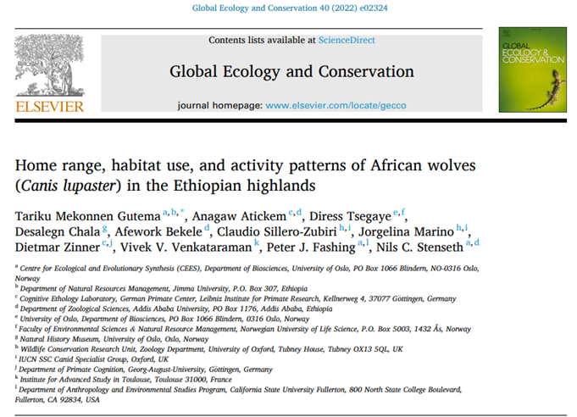
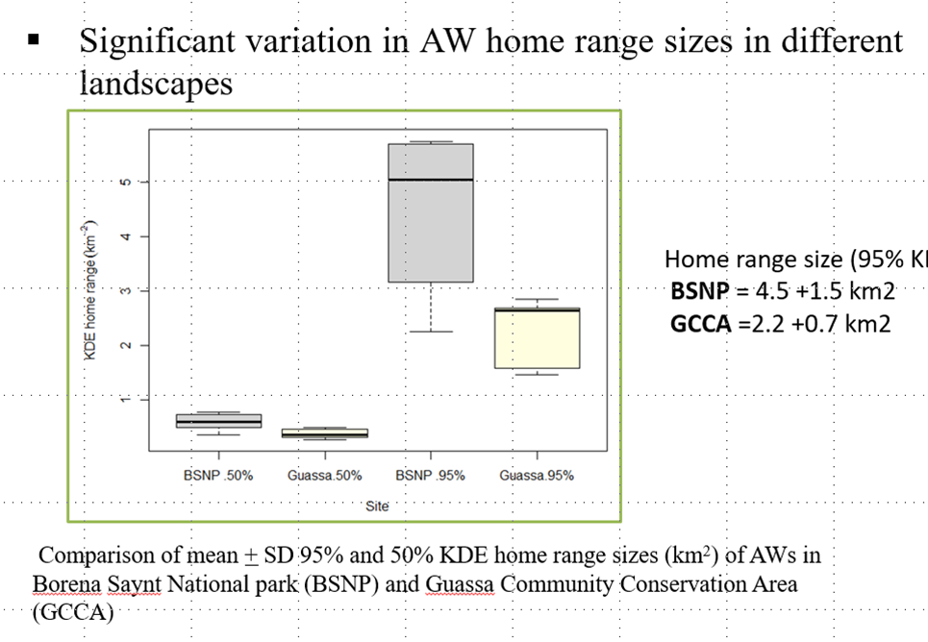

Slide 10
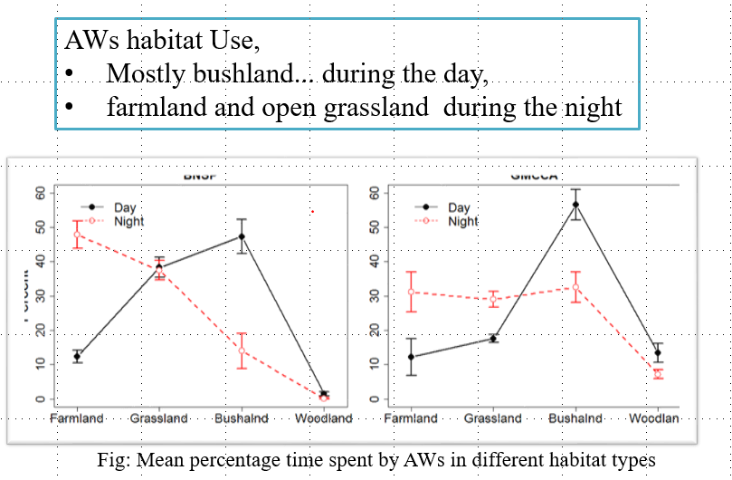
AW Habitat use and Activity pattern

Slide 11
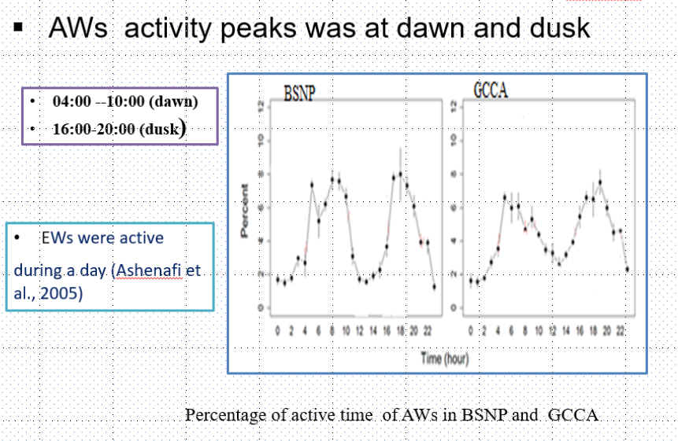
Activity pattern

Slide 12
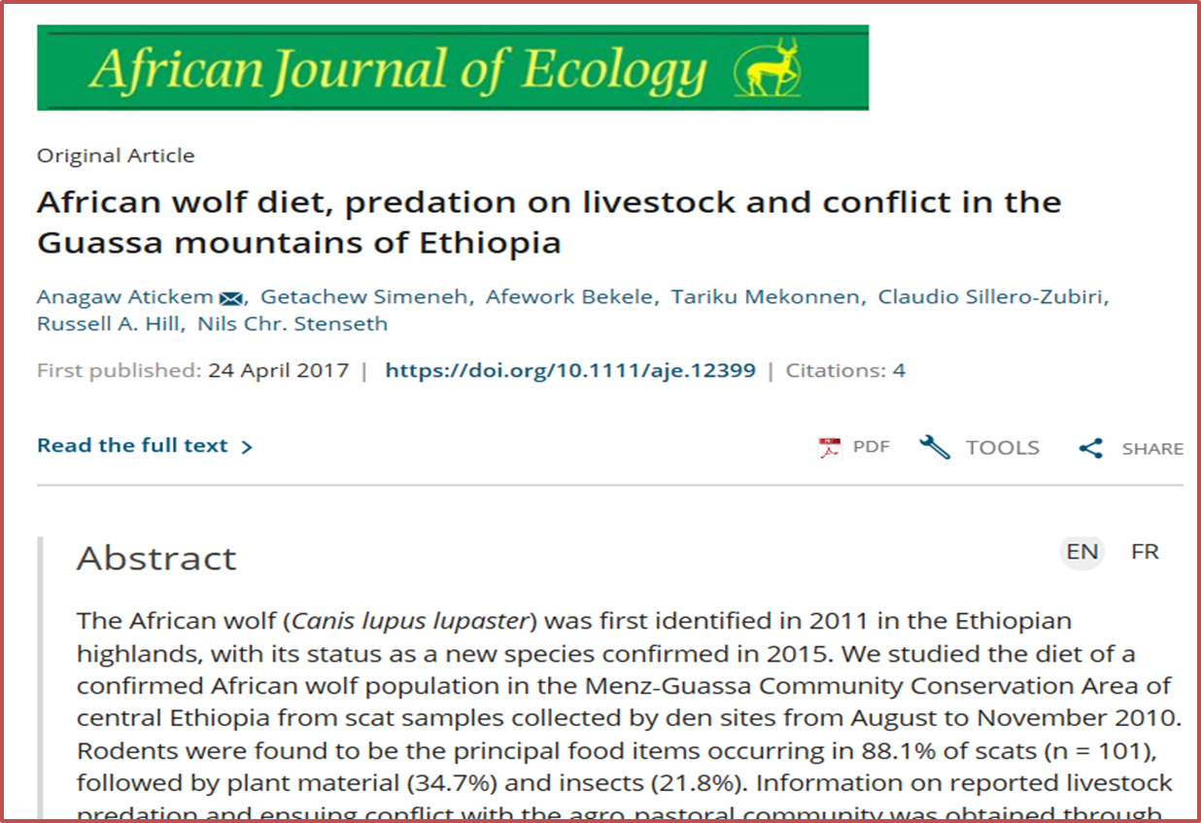
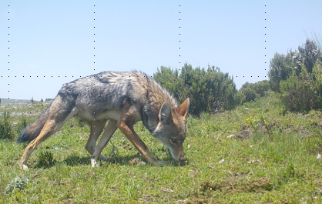
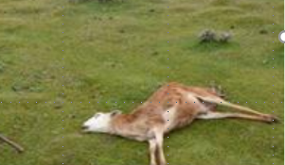
Human African Wolf Conflict
AWs were the most livestock predator in the GCCA (74.6%, n = 492)
Highest economic losses by AWs (78.9%, of the total)
The community had negative attitudes toward the AWs (80%)
only 14 % negative attitude toward EWs,

Slide 13
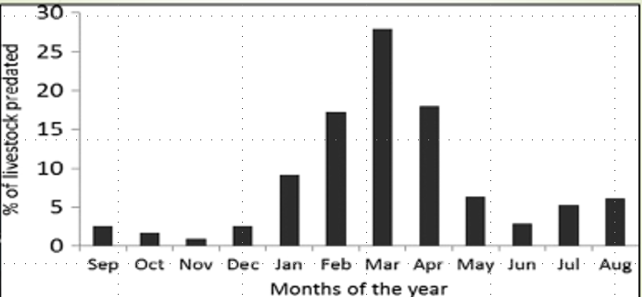
February to April were the highest predation season

Slide 14
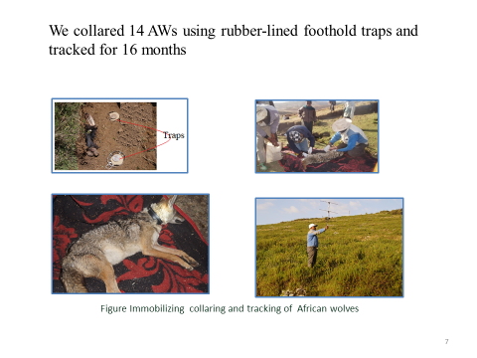
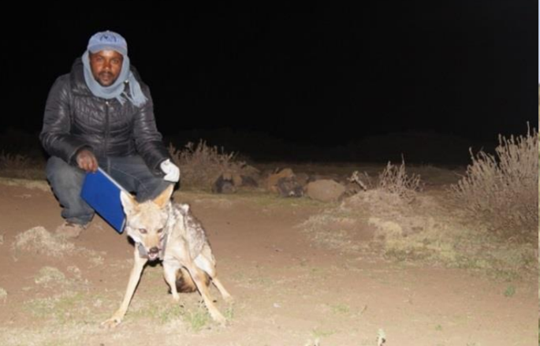
Methods used to study African wolf:
COLLARING

Slide 15
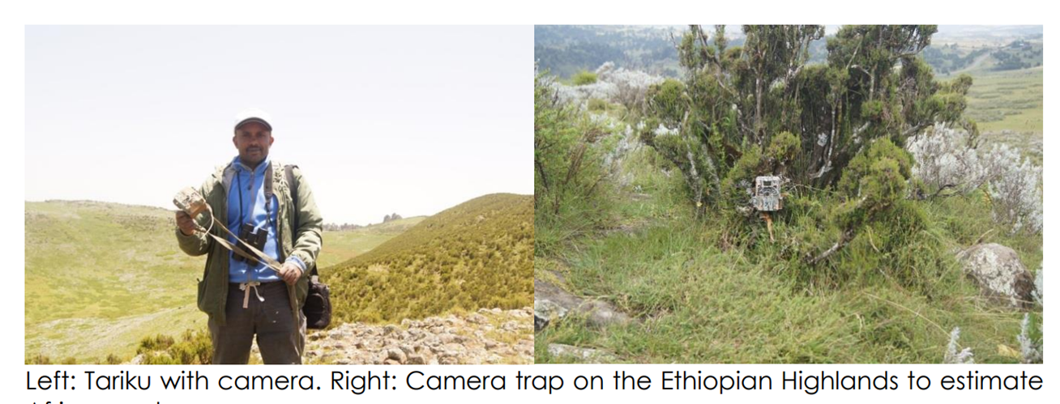
Camera trap

Slide 16

Call-up Methods

Slide 17
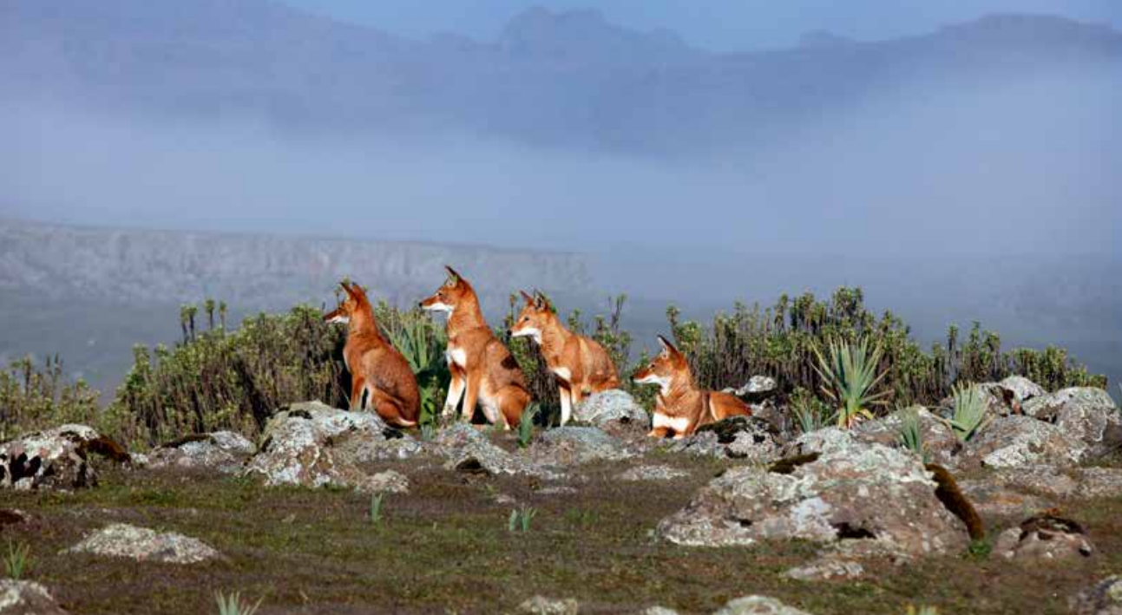
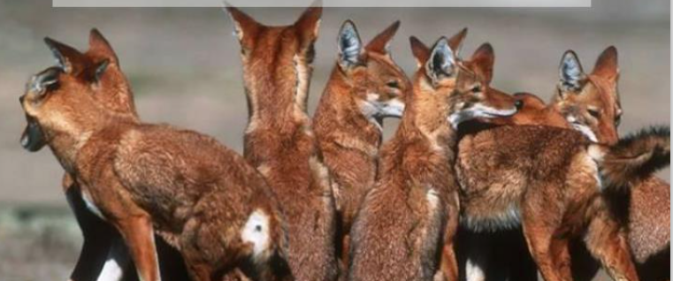
ECOLOGY OF ETHIOPIAN WOLF
Well studied by Ethiopian Wolf Conservation Program (EWCP)
Endangered, Less than 500 individual
Live in a group of 2-20 individuals and territorial

Slide 18
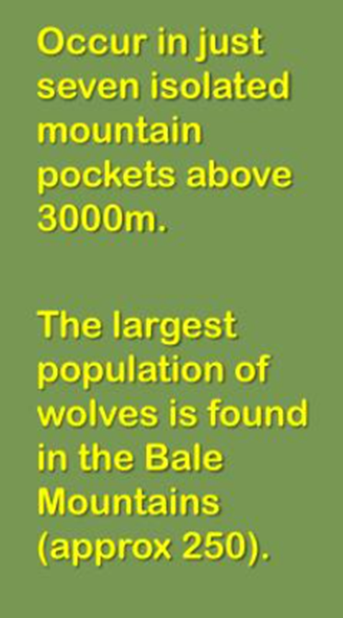
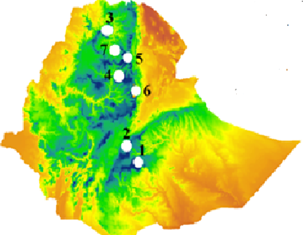
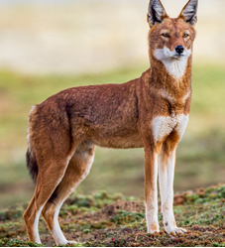
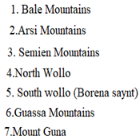
Ethiopian wolf Distribution
EWs are limited to seven Ethiopian highlands
Fig. Distribution of Ethiopian wolves (Marino and Sillero-Zubiri 2011)

Slide 19
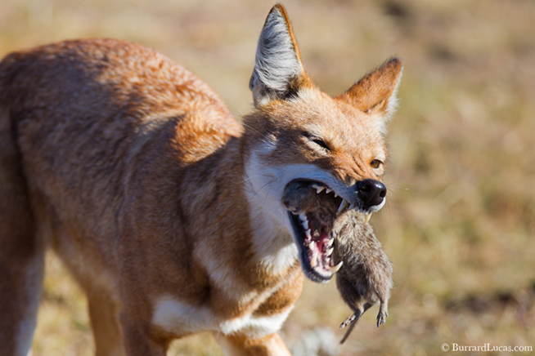
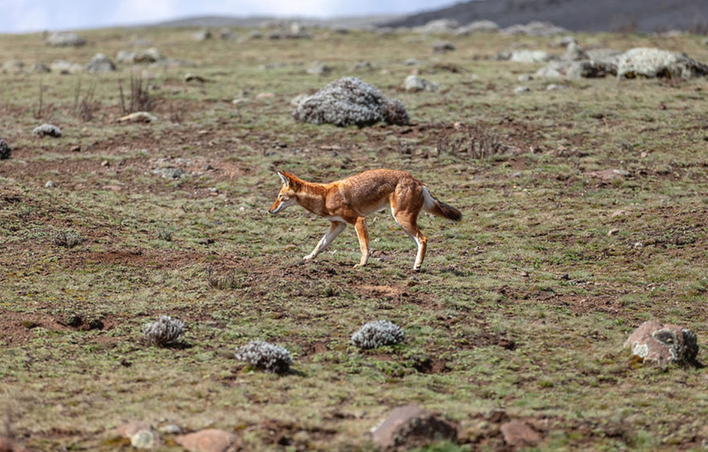
DIET specialist
Rodents are the Main diet of EW
solitary hunter
But occasionally, go on a group to hunt for Starck's hare

Slide 20
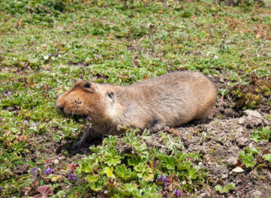
Giant mole rat ((Tachyoryctes macrocephalus)): the major diet of EWs on Bale mountains
Ethiopian wolf diet consists mainly of the giant mole rats and common grass rats that are abundant in their habitat

Slide 21
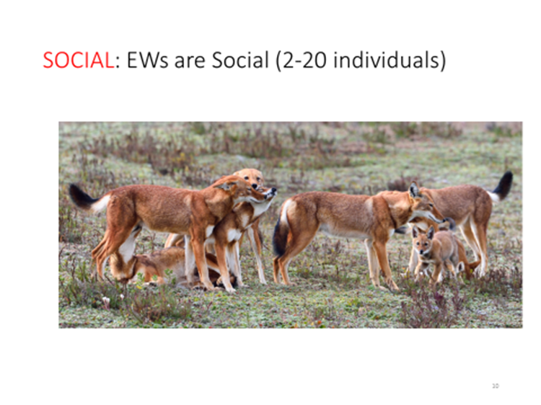

Slide 22

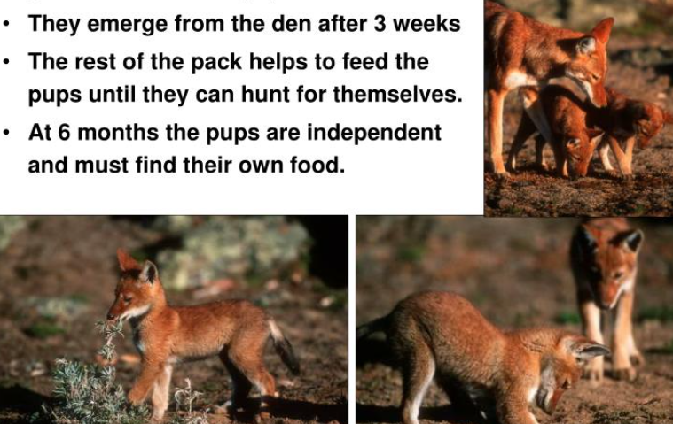
Reproduction

Slide 23
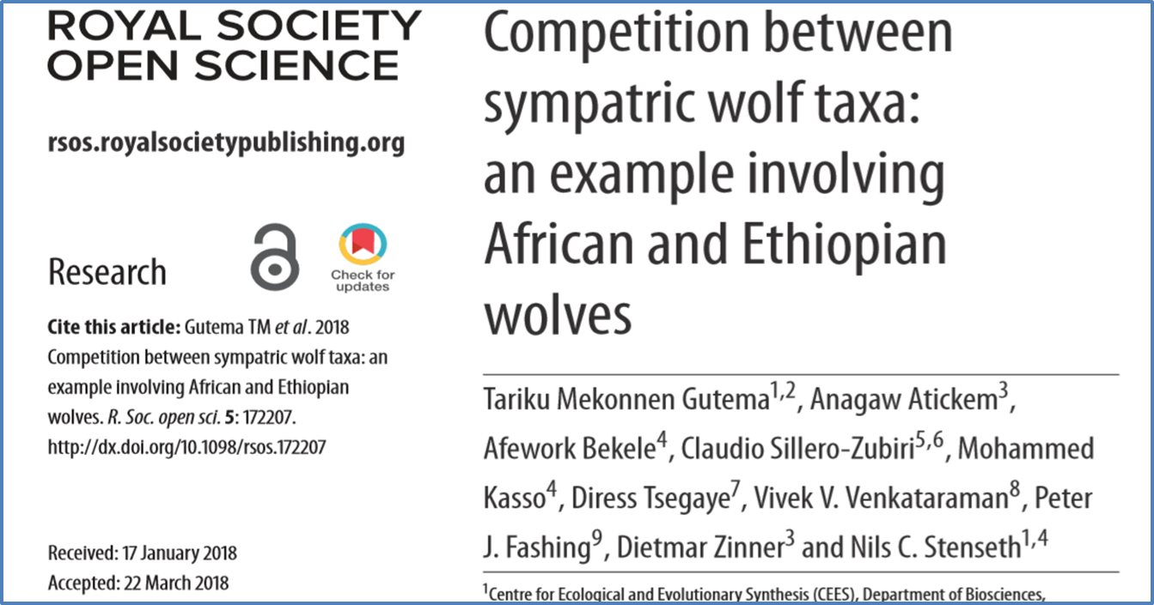
African wolf and Ethiopian wolf interaction

Slide 24
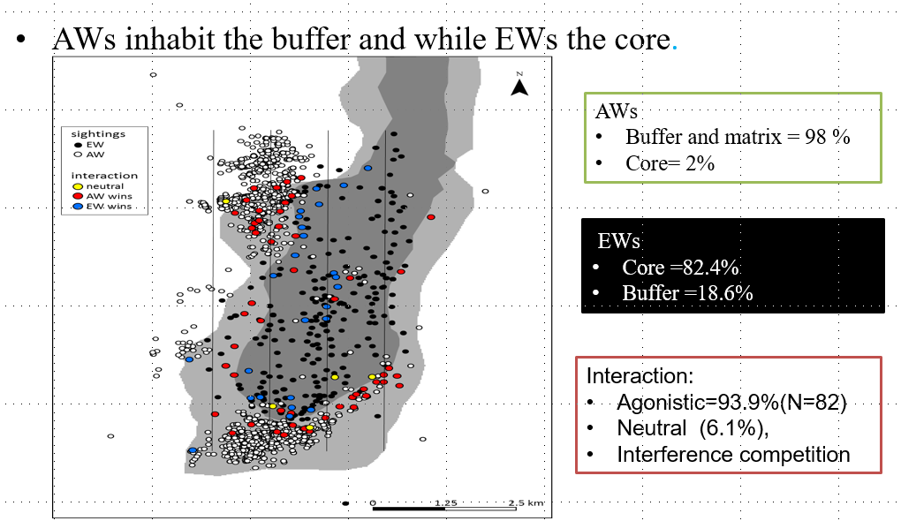
African wolves prefer areas near to settlement while Ethiopian wolves prefer undisturbed areas (the study from 14 collared African wolves)

Slide 25
The two wolf species fight to defend their homerange
From the total recorded interactions (N=82)
93.9% were agonistic
6.1% neutral

Slide 26
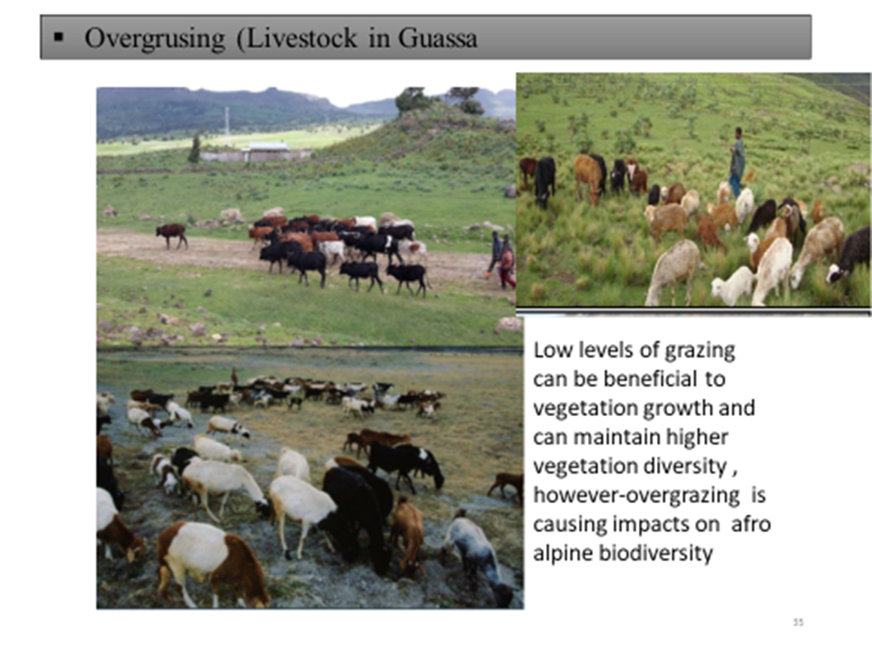
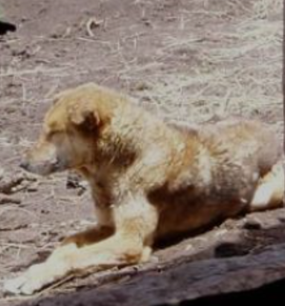
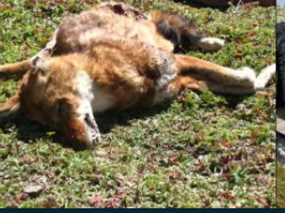
Major threats of Ethioian wolf
Disease
Habitat disurbance
Overgrazing
Domestic dog
Direct conflict

Slide 27
Recomendations
Reducing human encroachment and habitat loss
Local education
Protection of intact habitats to preserve habitat preferred by EWs
Alternative livelihood for human carnivore conflict

Slide 28
Acknowledgements
Financials support
The Rufford Foundation
Mohamed Bin Zayed Species Conservation
University of Oslo, CEES
Jimma University
Mohamed Bin Zayed Species Conservation
Fund

Slide 29
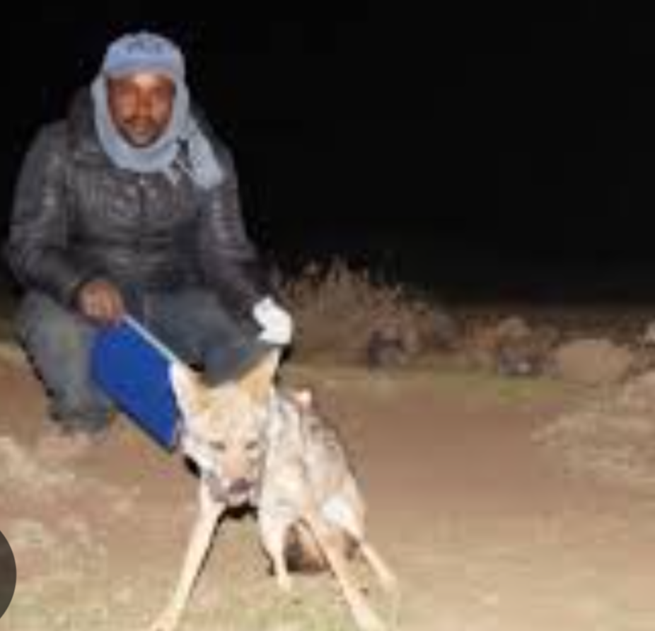
THANK YOU

